Slide 1
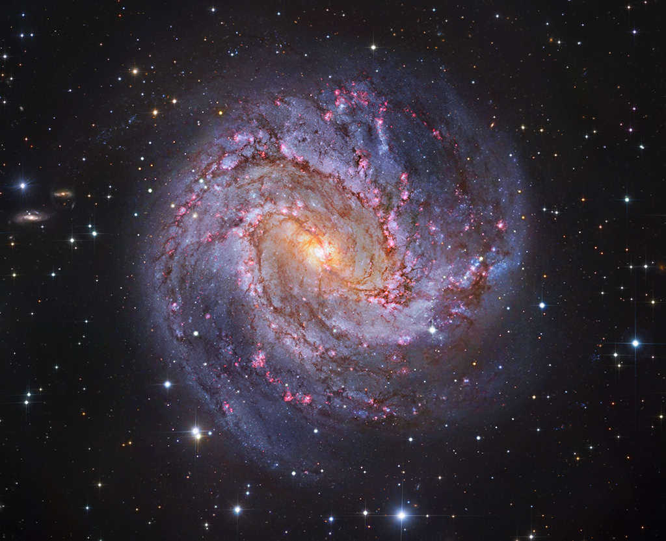
Characterizing the Dust and Cold-Gas Content of Nearby Star-Forming Galaxies
Sean MacBride

Slide 2
What are galaxies?
Gravitationally bound systems of matter
Composed of two types of matter
Baryonic matter
Dark matter

Slide 3
Baryonic components of galaxies
Stars
Formed from collapsing clouds of gas
Emit continuous radiation in the form of starlight
Gas
Molecular, neutral atomic, ionized atomic
Molecular phase drives star formation
Dust
Formed from collision of neutral atoms
Absorbs starlight efficiently
Notes:
End of slide: “Each of these components evolved through different processes. In order to understand the evolution processes of baryons in galaxies as a whole, an understanding of the components is necessary”

Slide 4
Star-forming galaxy structure
Central component
Older stellar population
Central supermassive black hole
Classified as bulge, pseudobulge, or bar
Disk
Spiral arms of gas and young stars
Active star formation in arms
Dust prevalent near young stars

Slide 6
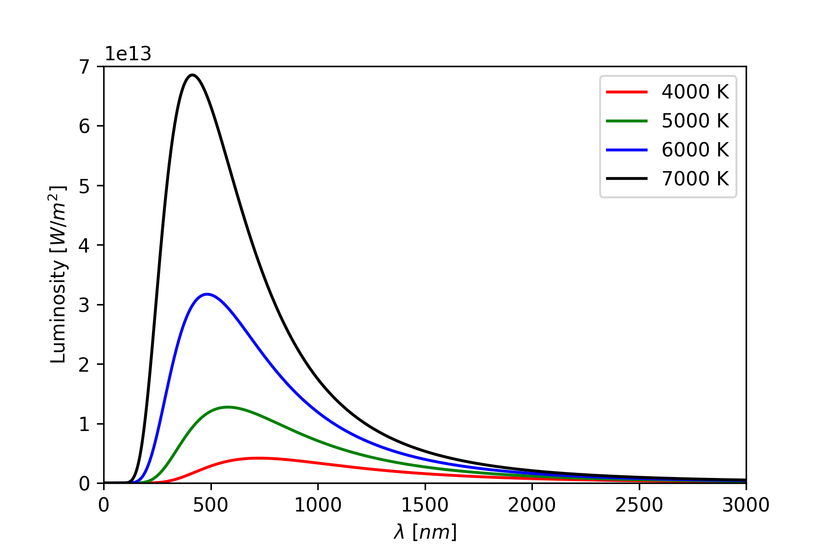
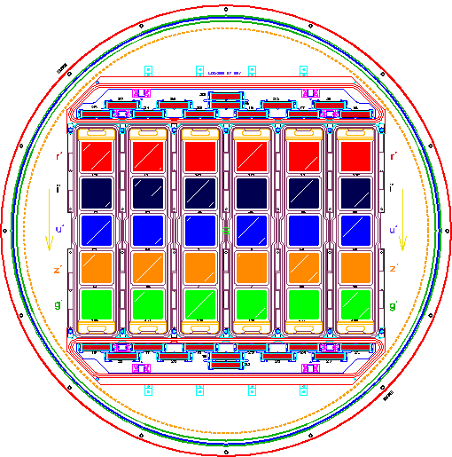
Observational signatures of galaxies
Photons exhibit wave-particle nature
Spectroscopy
Analysis of the wave nature of light
Range of wavelengths emitted
Spectra modulated by intervening material
Photometry
Analysis of the particle nature of light
Measurement of total brightness
Optical filters measure color brightness

Slide 7
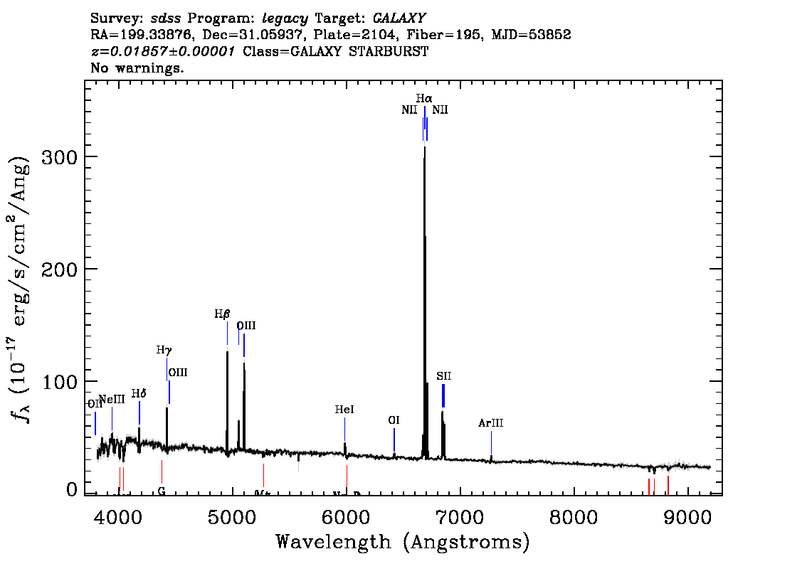
Features of a light spectrum
Continuous spectrum is modulated
by intervening material
Light passing through cool gas is absorbed
Absorption feature from gas
Absorbed energy from gas is emitted
Emission feature from gas
Features of spectrum inform conclusions
about the chemical composition of source

Slide 8
Spectrum of a star-forming galaxy
H⍺ → 6562 Å
n=3 → n=2 transition
Red in color
Hβ → 4861 Å
n=4 → n=2 transition
Blue in color
Emitted from regions of star formation

Slide 9
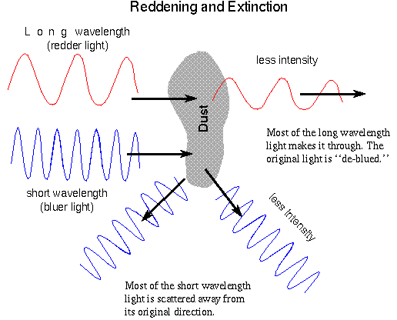

Light extinction A(λ)
Photons can interact with intervening matter
Dust and gas remove light from spectra in
two ways
Absorption
Scattering
Diminishes light intensity
Extinction is most effective when λ ≲ size of intervening material
Shorter wavelength light is removed more effectively
Brightness of source in astronomy is represented in magnitude
$$m\left(λ\right)=m_{0}\left(λ\right)+A(λ)$$

Slide 10

Light extinction relationships
$$m\left(λ\right)=m_{0}\left(λ\right)+A(λ)$$
Selective extinction or color index E(B-V)
$$E\left(B−V\right)=A\left(B\right)−A(V)$$
Ratio of total-selective extinction R_{V}
$$R_{V}=\frac{A(V)}{E(B−V)}$$
Extinction is determined from flux reduction of object
$$A\left(λ\right)=−2.5\log\left(\frac{F_{λ}}{F_{λ,0}}\right)$$
Notes:
Lambda V= 550 nm - green
Lambda B= 440 nm - blue

Slide 11

Extinction of the Balmer decrement
$$A\left(λ\right)=−2.5\log\left(\frac{F_{λ}}{F_{λ,0}}\right)$$
Extinction at H⍺ and Hβ
$A\left(H⍺\right)=−2.5\log\left(\frac{F_{H⍺}}{F_{H⍺,0}}\right)$ $A\left(\text{Hβ}\right)=−2.5\log\left(\frac{F_{Hβ}}{F_{Hβ,0}}\right)$
Balmer Decrement $≡\frac{F_{H⍺}}{F_{Hβ}}=\frac{F_{H⍺,0}}{F_{Hβ,0}}{10}^{−0.4[A\left(H⍺\right)−A\left(Hβ \right)]}$
Empirical prescriptions for ${A(λ)}/{A(V)}$ (Cardelli, Clayton, Mathis 1989)
$$BD={BD}_{0}{10}^{−0.4[A\left(H⍺\right)−A\left(Hβ \right)]\frac{A(V)}{A(V)}}={BD}_{0}{10}^{−0.4×A(V)\left[\frac{A\left(H⍺\right)}{A\left(V\right)}−\frac{A\left(Hβ \right)}{A(V)}\right]}$$

Slide 12
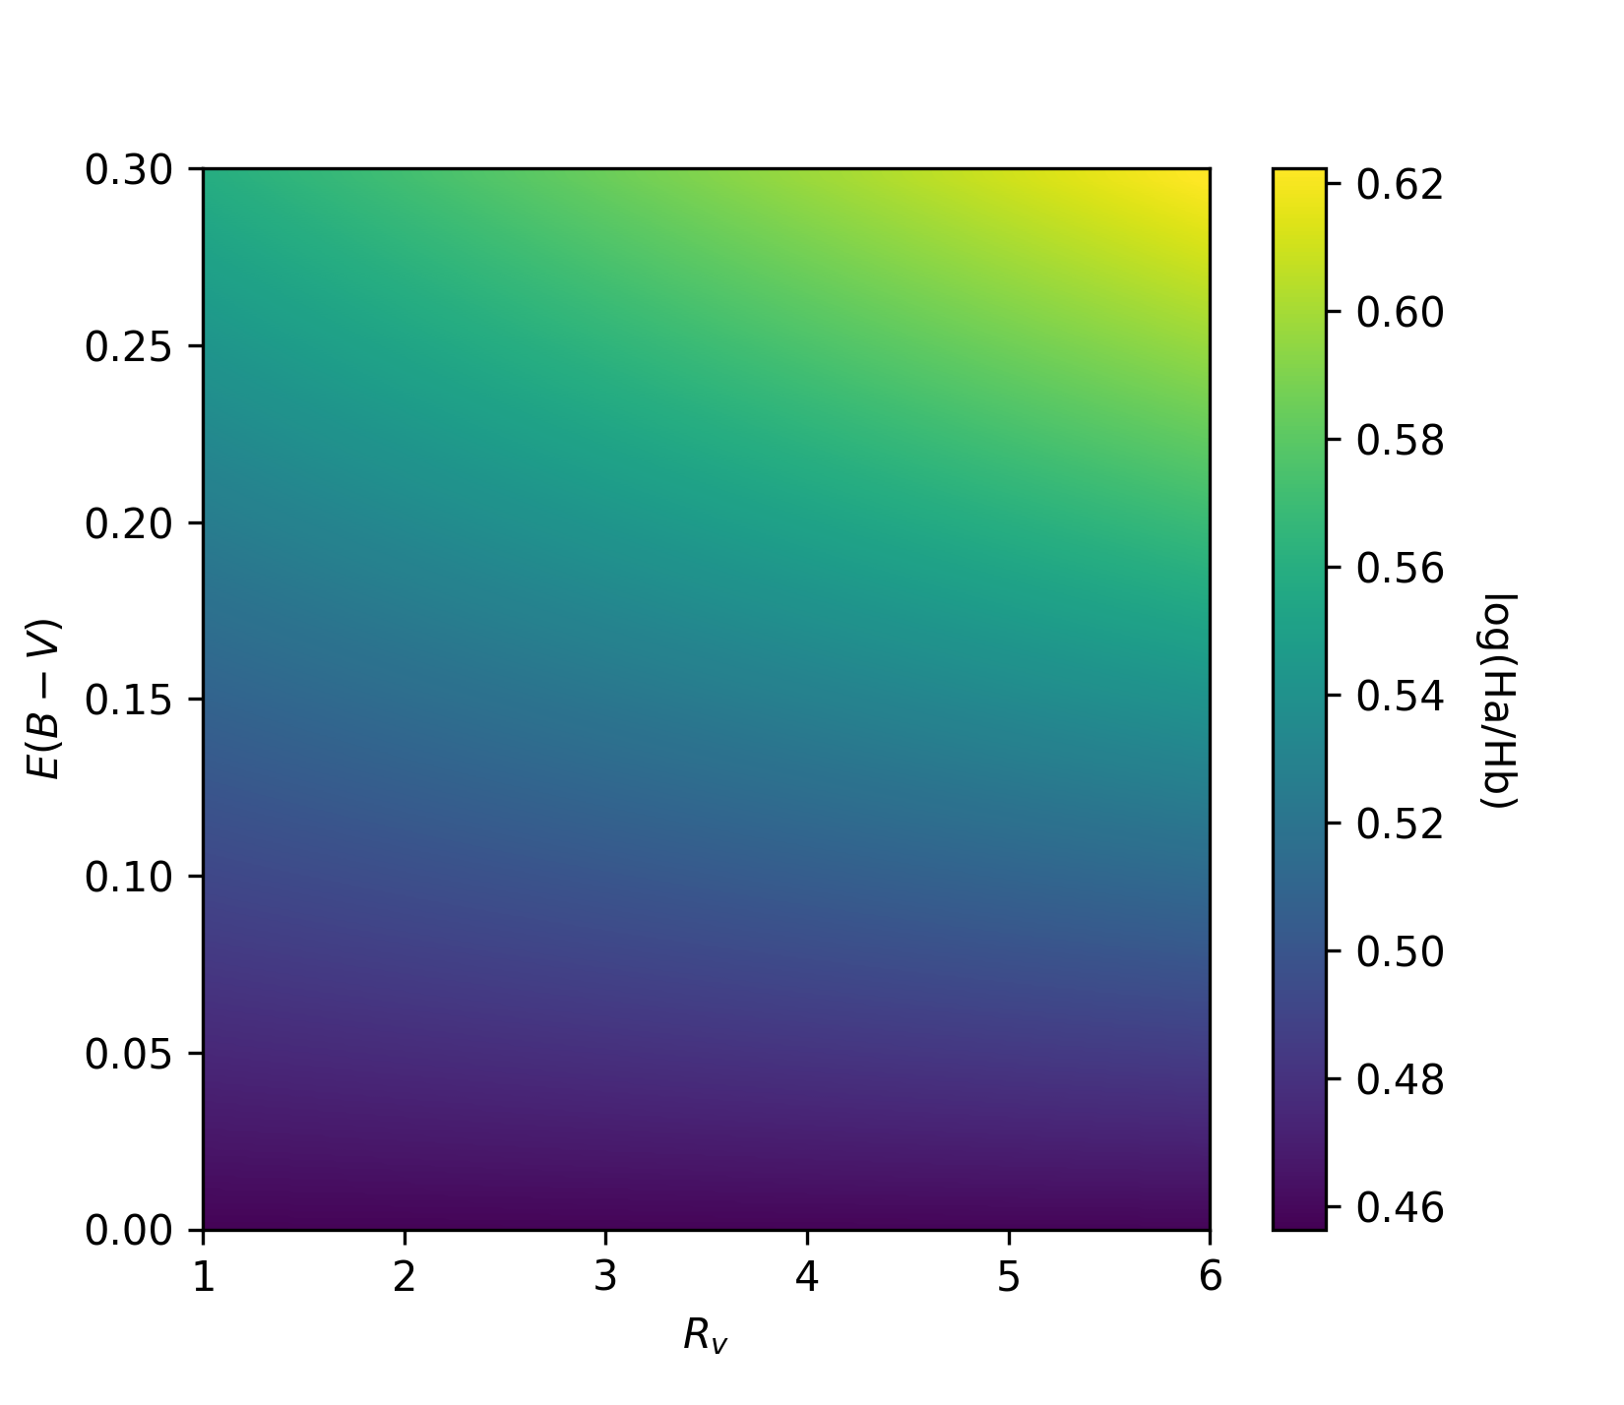

Modeling extinction of Balmer decrement
Using $R_{V}=\frac{A(V)}{E(B−V)}$, model becomes
$$BD={BD}_{0}{10}^{−0.4×E(B−V)×R_{V}\left[\frac{A\left(H⍺\right)}{A\left(V\right)} − \frac{A\left(Hβ \right)}{A(V)}\right]}$$
λ⍺>λ_{β}, so H⍺ is suppressed less than Hβ
Environments with higher extinction have higher observed Balmer decrement

Slide 13
Notes:
NGC 1055

Slide 14
Notes:
M83

Slide 15
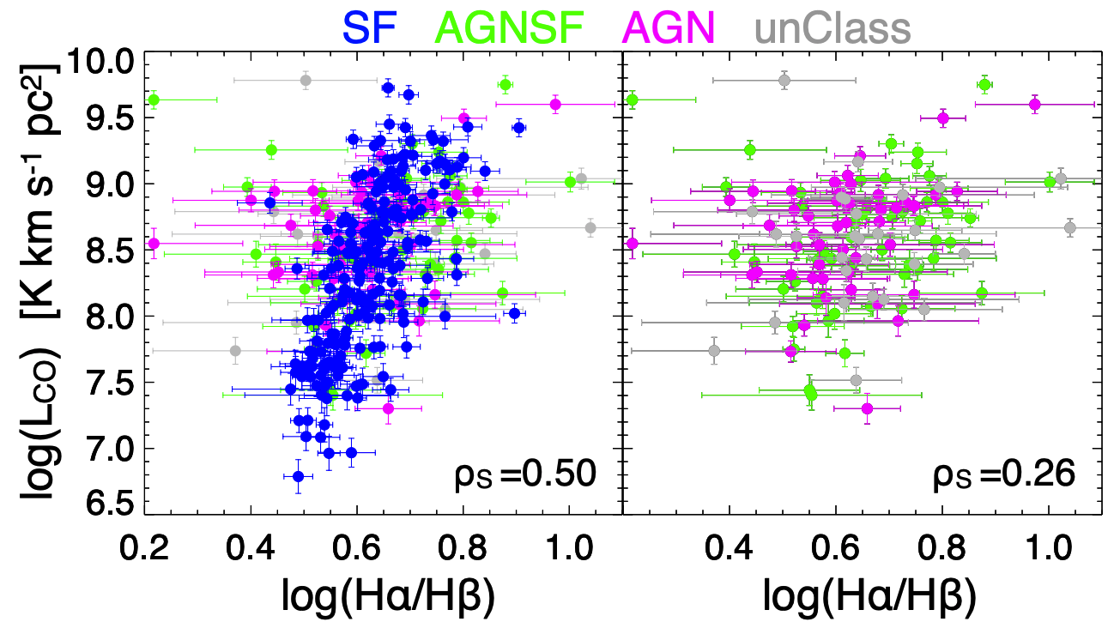

Balmer decrement as a tracer
$\frac{F_{H⍺}}{F_{Hβ}}$ is modulated from intervening matter
Environmental effects on Balmer emission
Star forming galaxies
Minimal (<1%) AGN contribution to Balmer emission
Active galactic nuclei (AGN)
Significant Balmer emission from galactic center
Passive galaxies
Weak Balmer emission
Balmer emission in star-forming galaxies traces intervening material
Concas, Alice, and Paola Popesso. “A New Empirical Method to Estimate the Molecular Gas Mass in Galaxies.” Monthly Notices of the Royal Astronomical Society: Letters, vol. 486, no. 1, 2019

Slide 16
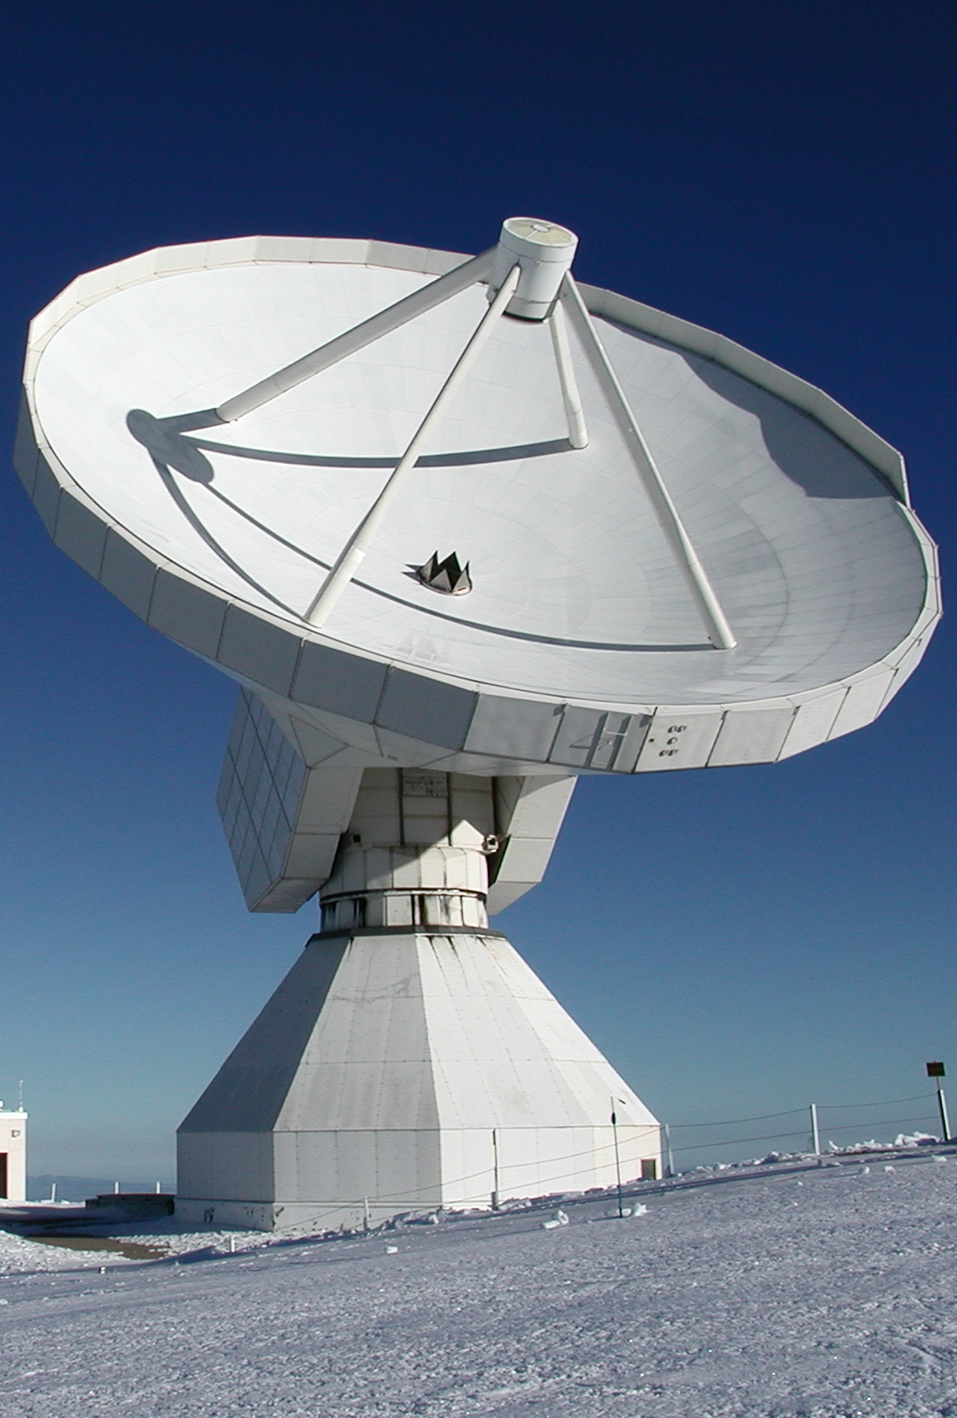

Observations of cold molecular gas
H₂ dominates the interstellar medium
Cold environment inhibits emission
CO_{1→0} 2.6mm emission can be used as a proxy
$$M_{H_{2}}=α_{CO}L_{CO}$$
Correction factor $α_{CO}$ accounts for metallicity and ionizing radiation effects
Observations using IRAM 30m telescope
xCOLD GASS – Legacy survey of CO emission

Slide 17
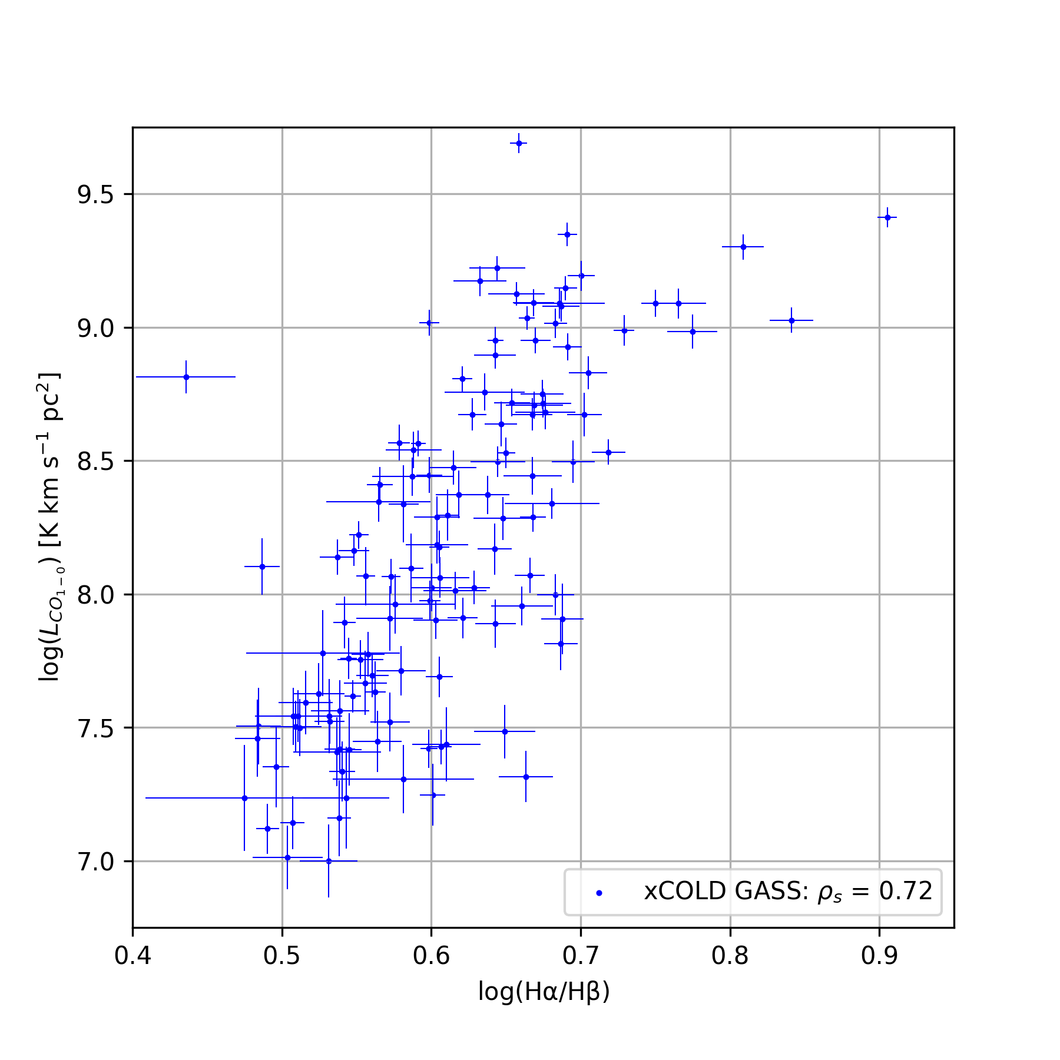
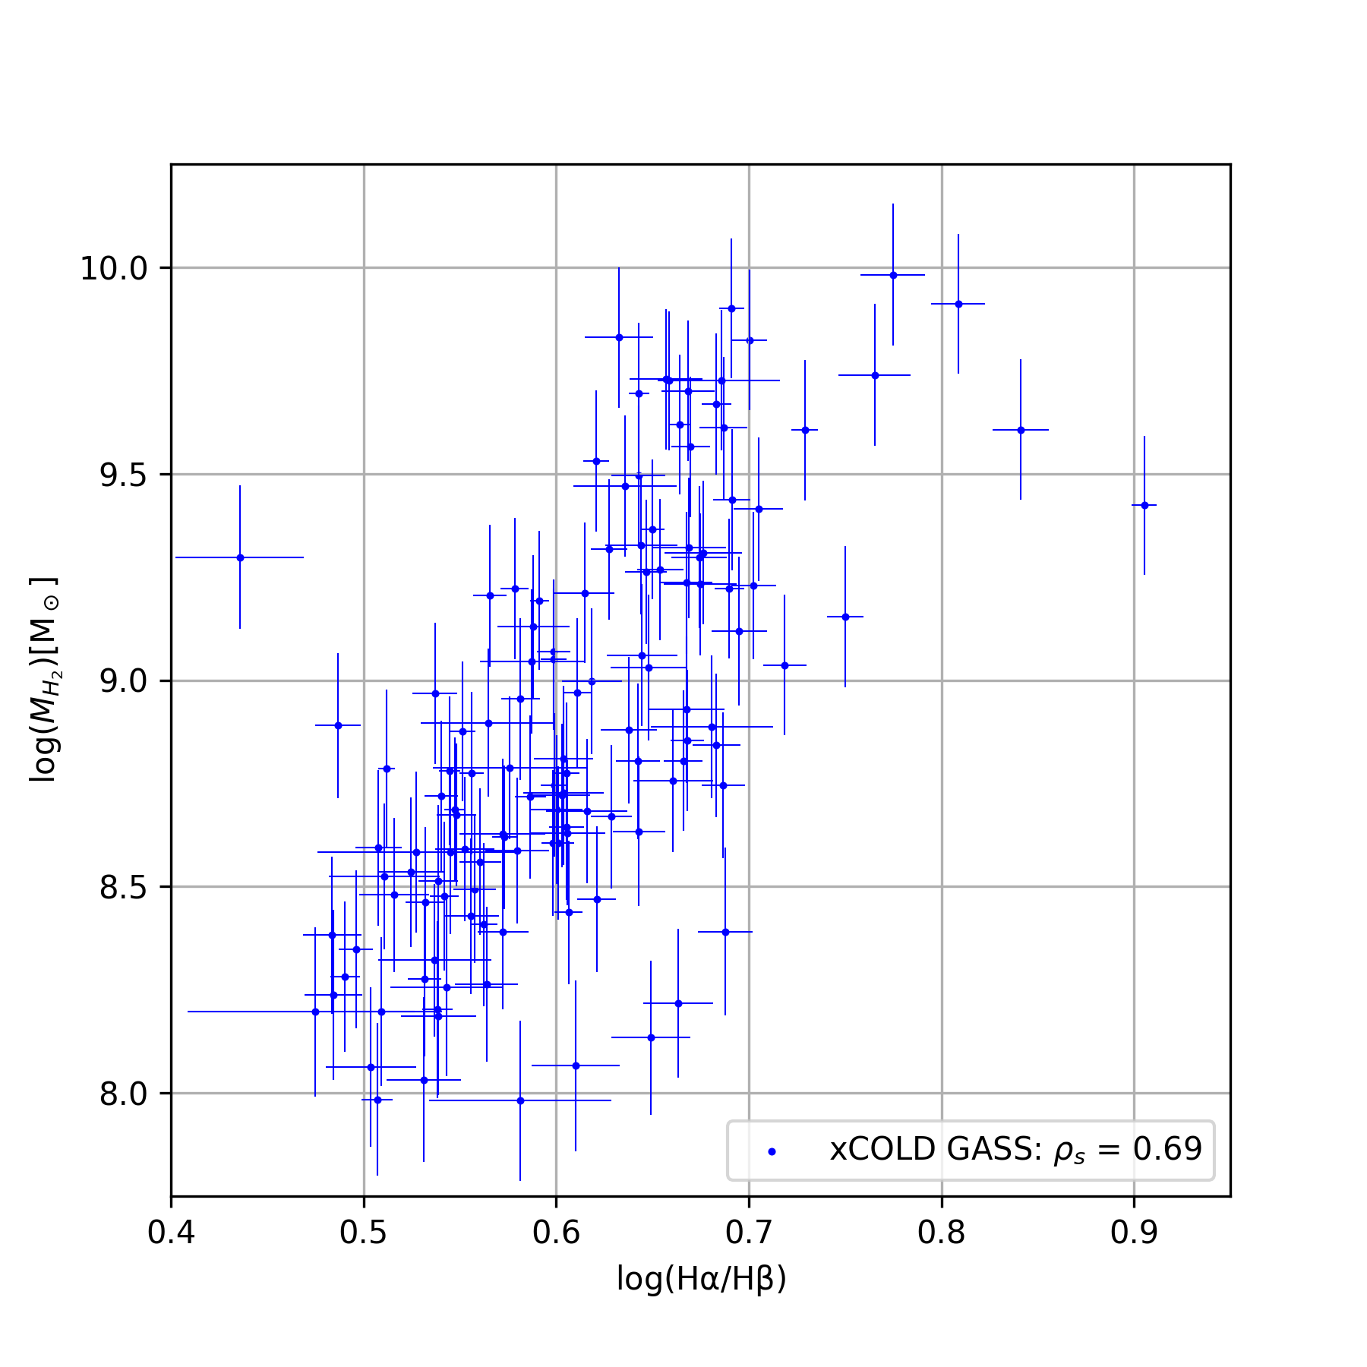

Slide 18
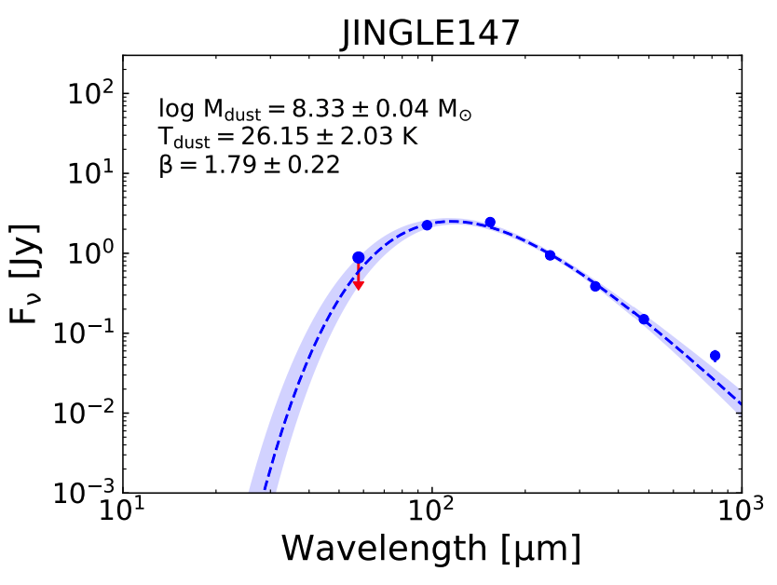
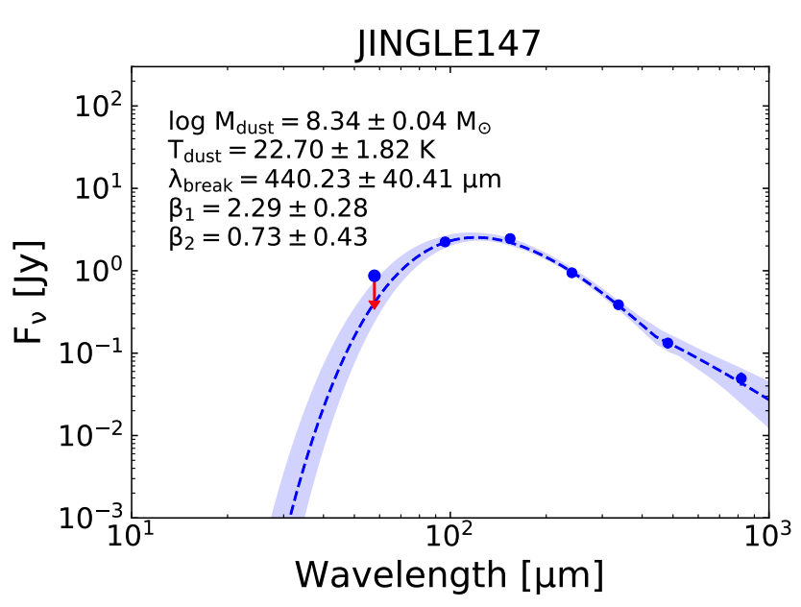
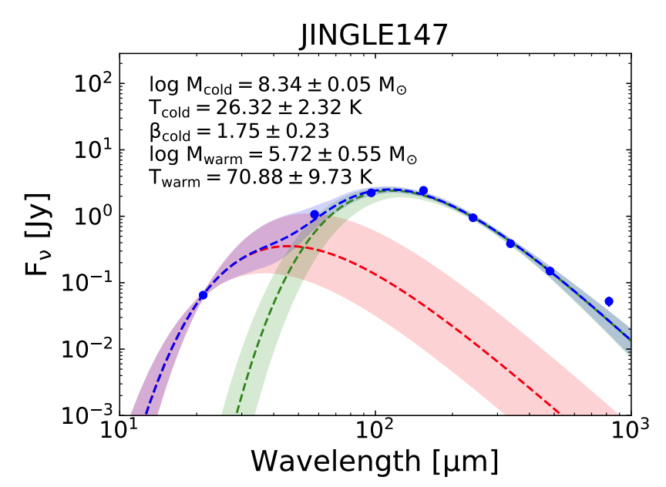
Observations of dust
Lamperti, Isabella, et al. “JINGLE V: Dust Properties of Nearby Galaxies Derived from Hierarchical Bayesian SED Fitting.” Monthly Notices of the Royal Astronomical Society, 2019.
Photometric results in a range of passbands
22μm (WISE), 60μm (IRAS), 100μm, 160μm (Herschel/PACS), 250μm, 350μm, 500μm (Herschel/SPIRE), and 850μm (SCUBA-2)
Strength of incident radiation against wavelength
Spectral energy distribution – SED
SED fit to different dust emissivity models
Models dependent on type of dust population and temperature

Slide 19
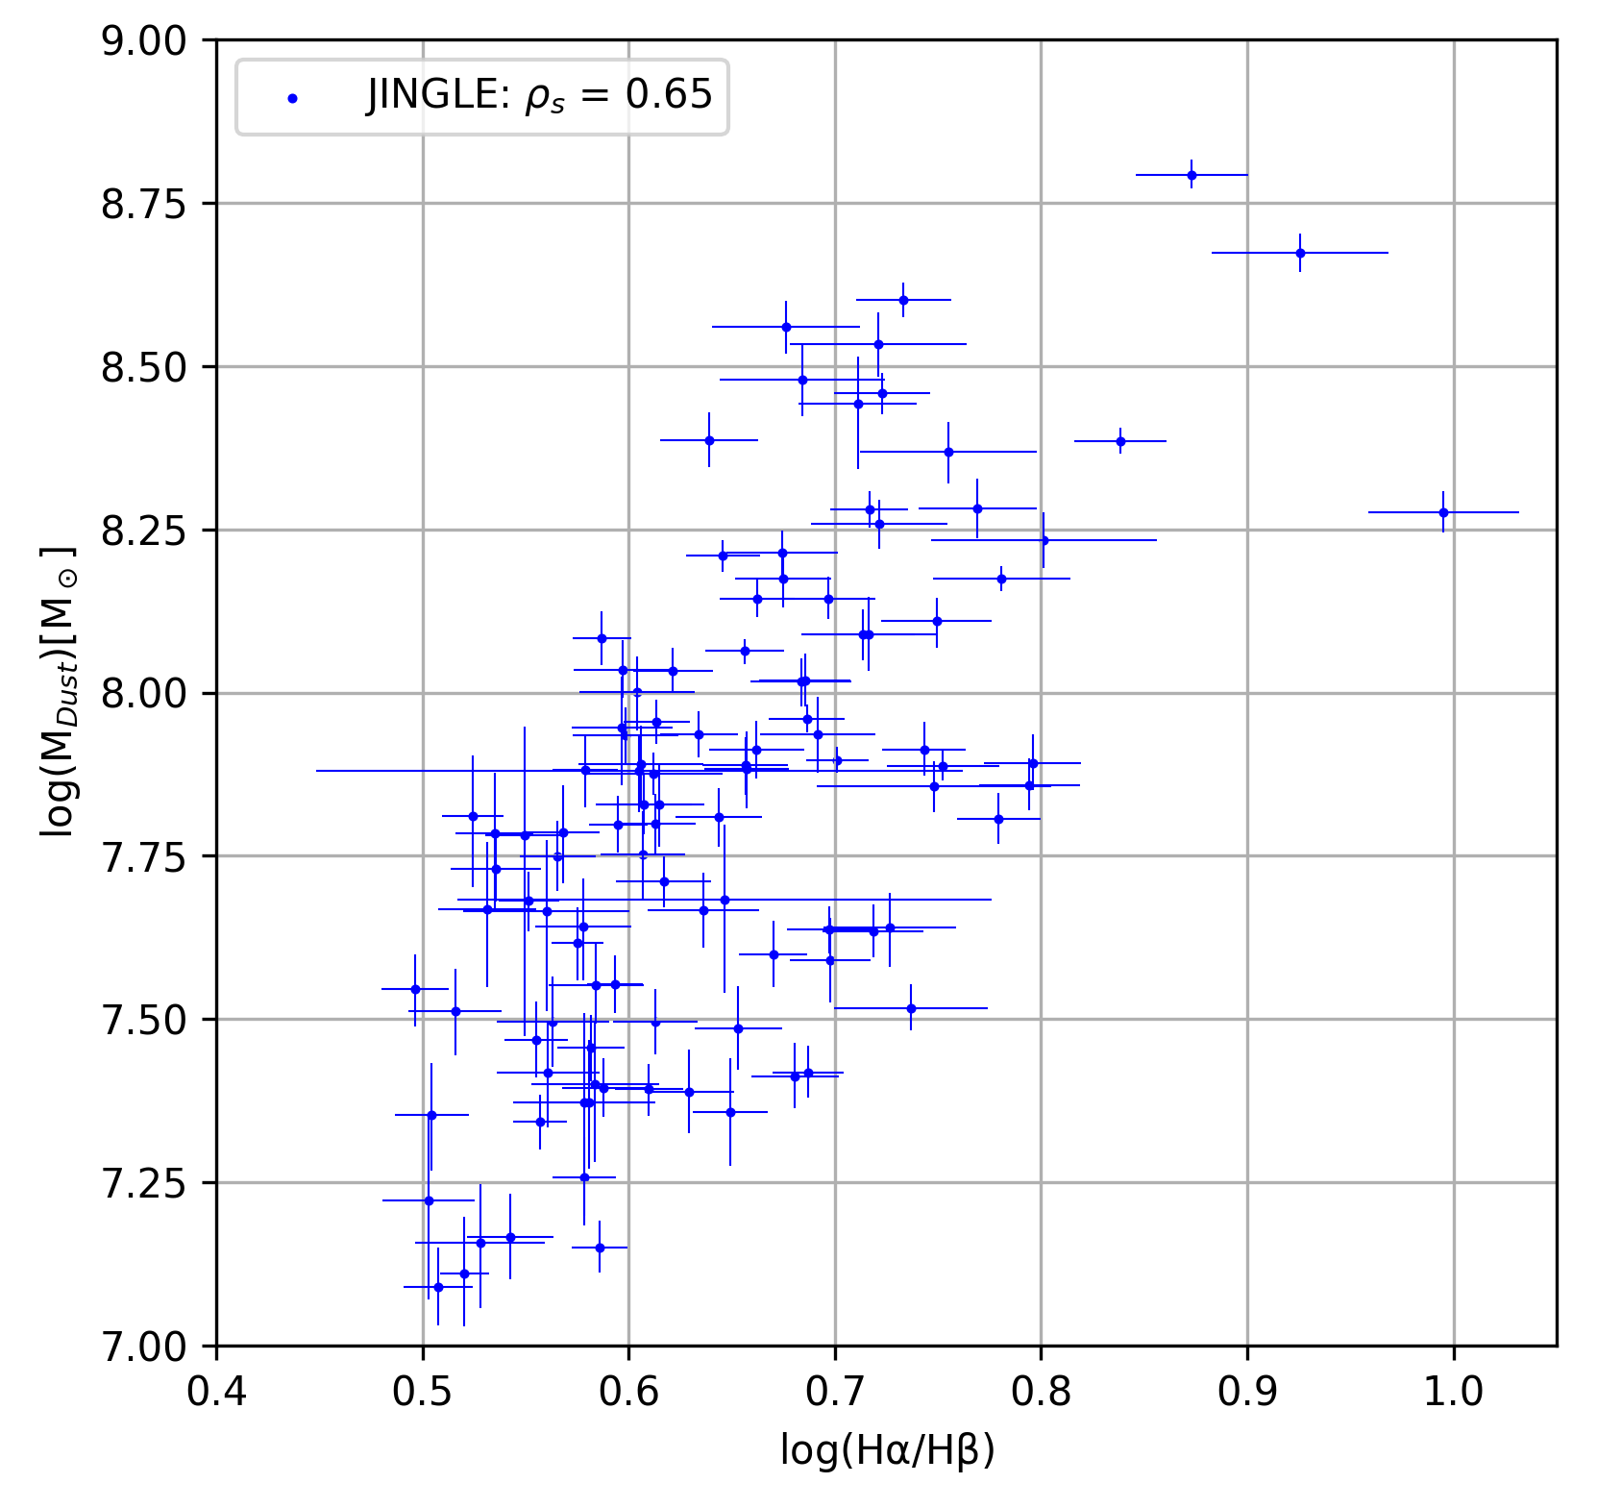

Slide 20
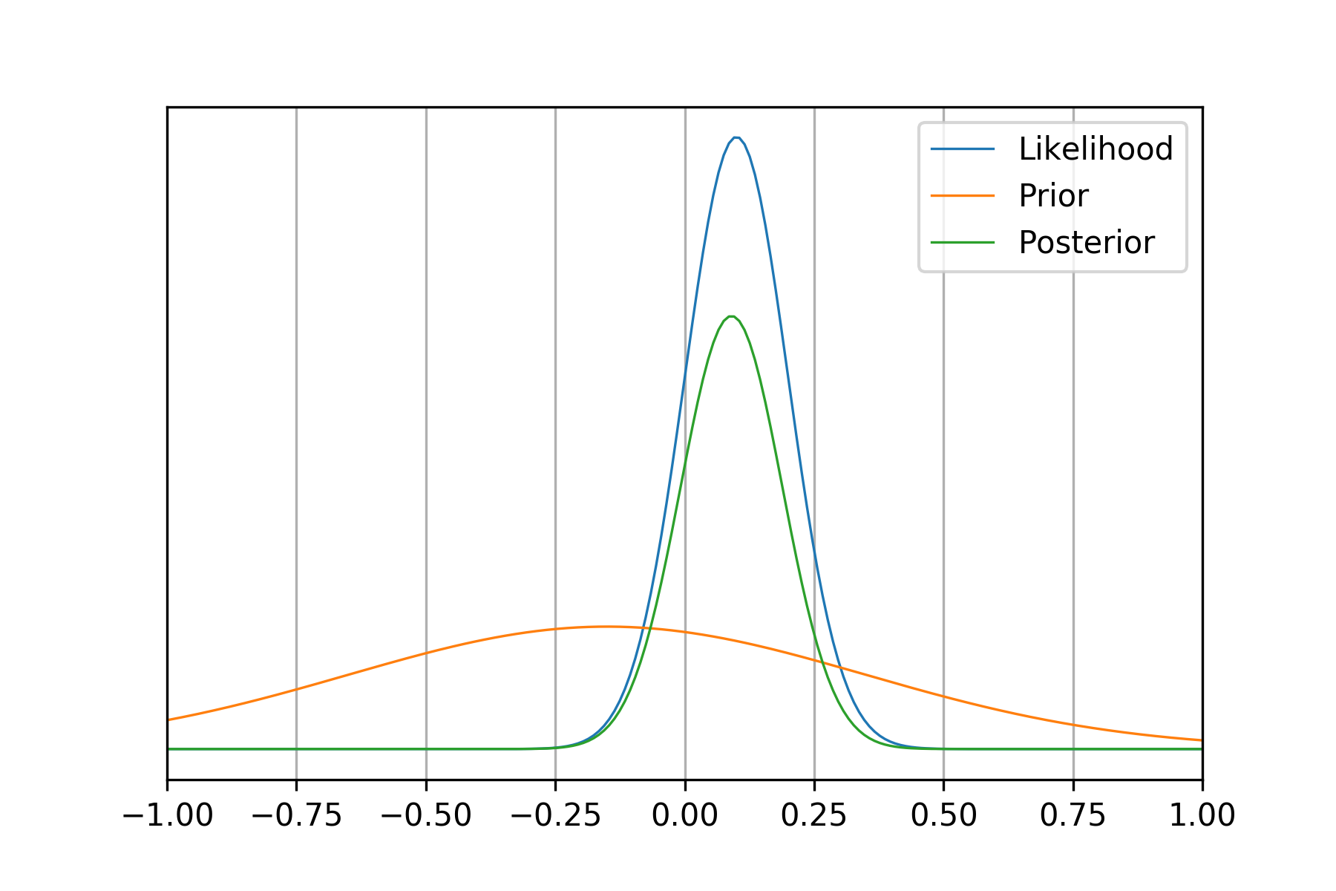

Monte-Carlo Markov chain
Optimize $M_{∎}=m×\left(\frac{F_{H⍺}}{F_{Hβ}}\right)+b$ with $M_{∎}=\left\{L_{{CO}_{1→0}},M_{H_{2}},M_{Dust}\right\}$
Approximate m, b, and intrinsic scatter f
Parameters found by approximating posterior distribution of sample
Posterior ∝ Likelihood × Prior
Likelihood is determined from sample
Prior is determined from previous beliefs

Slide 21
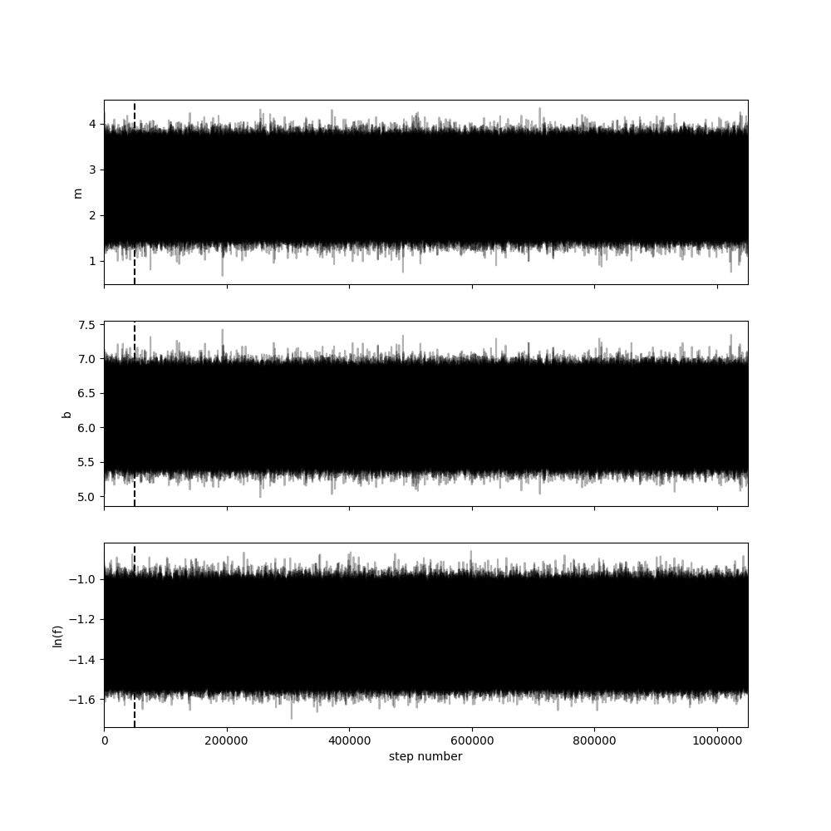
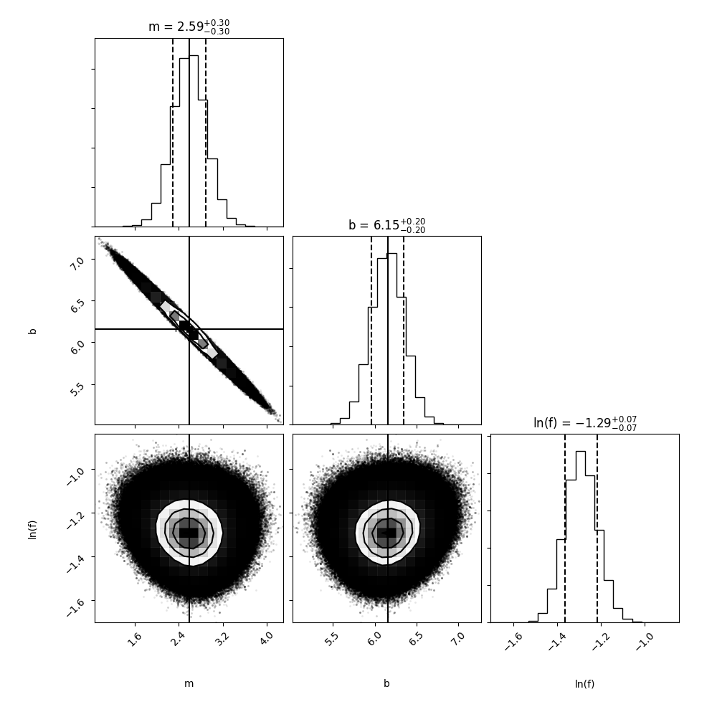

Monte-Carlo Markov chain
Optimize $M_{∎}=m×\left(\frac{F_{H⍺}}{F_{Hβ}}\right)+b$ with $M_{∎}=\left\{L_{{CO}_{1→0}},M_{H_{2}},M_{Dust}\right\}$
Construct chains of parameters to explore parameter space
Initial guess based on sample data
Converge on model parameters that
best approximate posterior of sample
Early section of chain discarded
as “burn-in” period
Density distribution drawn from resulting chain

Slide 22
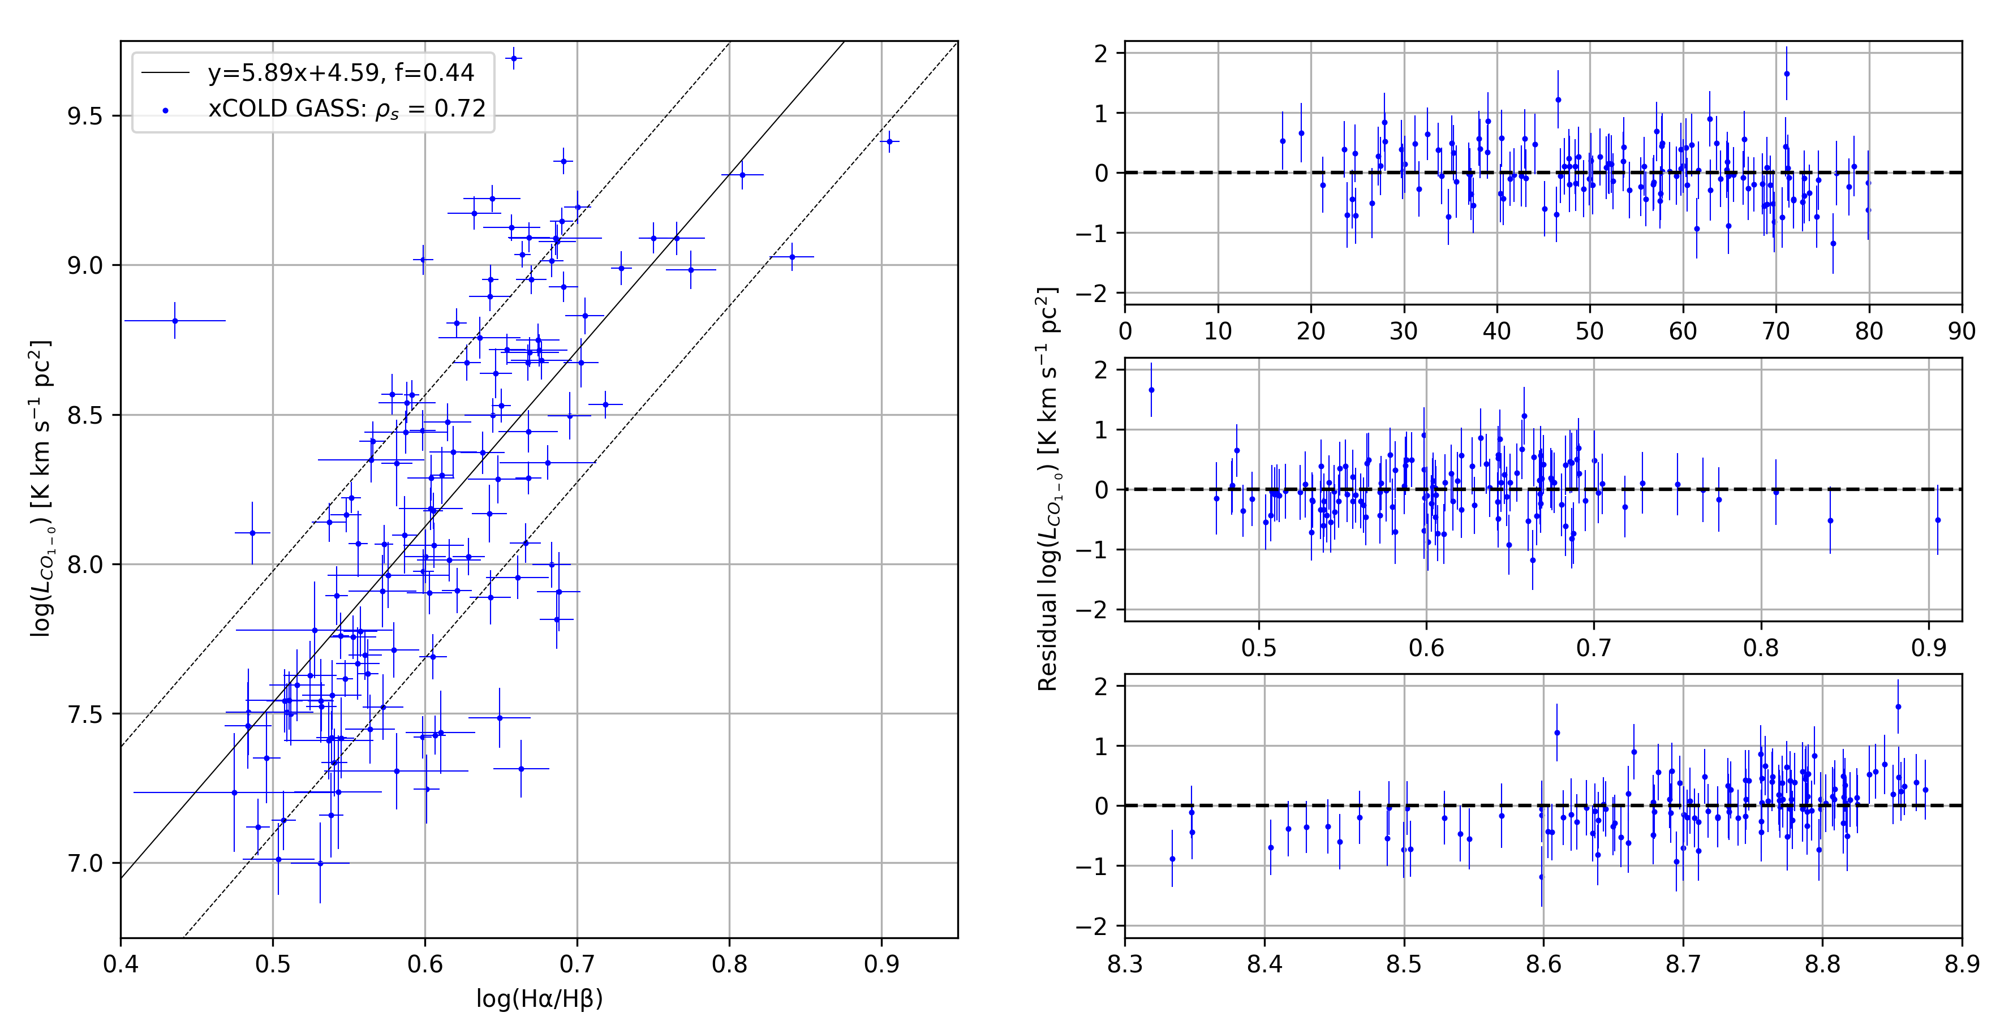

$L_{{CO}_{1→0}}$ calibration
Compare calibration to sample residuals
Find dependencies in calibrated values
Inclination dependence
Independent of Balmer decrement
Metallicity dependent

Slide 23
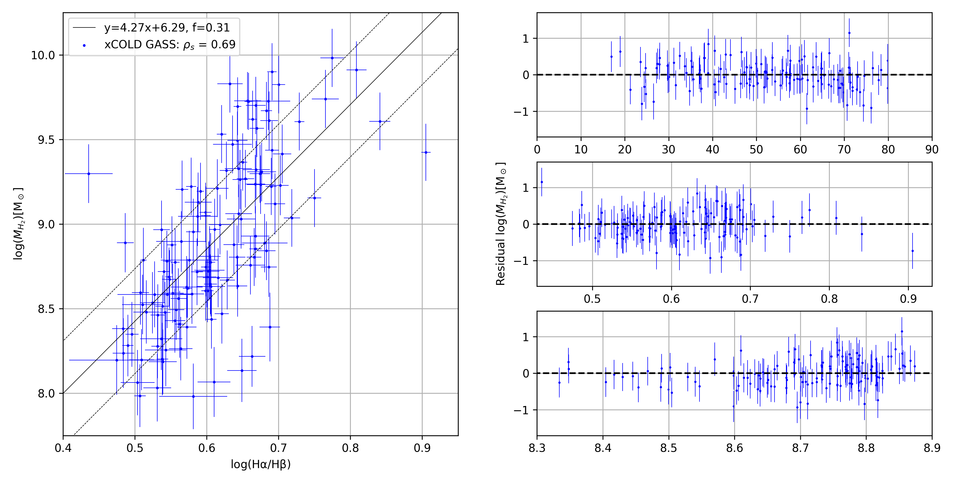

$M_{H_{2}}$ calibration
Compare calibration to sample residuals
Find dependencies between calibrated values and sample
Minor inclination dependence
Independent of Balmer decrement
Metallicity independent

Slide 24
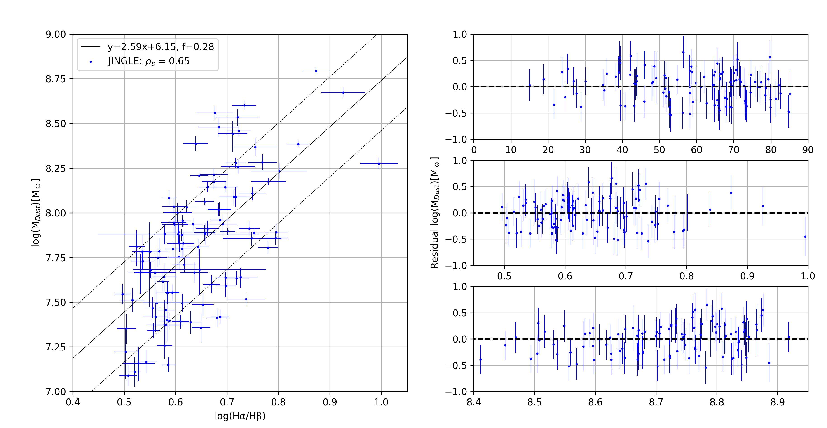

$M_{Dust}$ calibration
Compare calibration to sample residuals
Find dependencies between calibrated values and sample
Inclination independent
Independent of Balmer decrement
Metallicity independent

Slide 25

MCMC calibration results
$L_{{CO}_{1→0}}$ calibration
Independent of Balmer decrement
Metallicity and inclination dependent
Conversion factor $α_{CO}$ includes metallicity
$M_{H_{2}}$ calibration
Independent of metallicity, Balmer decrement
Minor inclination dependence?
$M_{Dust}$ calibration
Independent of metallicity, Balmer decrement, and inclination
Apply $M_{H_{2}}$ and $M_{Dust}$ calibration to sample of similar galaxies

Slide 26
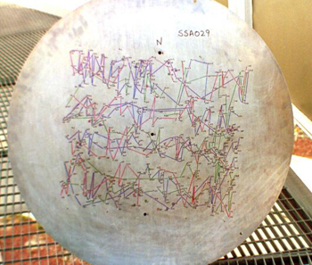
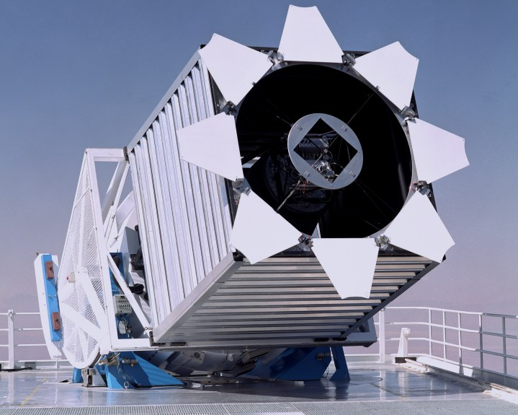

Sloan Digital Sky Survey
Observations at 2.5m Apache point observatory
Spectroscopic and photometric survey
Stellar mass, star-formation rates, emission measurements
Galaxy measurements from data release 7 (DR7)
Examine $M_{H_{2}}$ and $M_{Dust}$ calibration to 54,465 similar galaxies

Slide 27
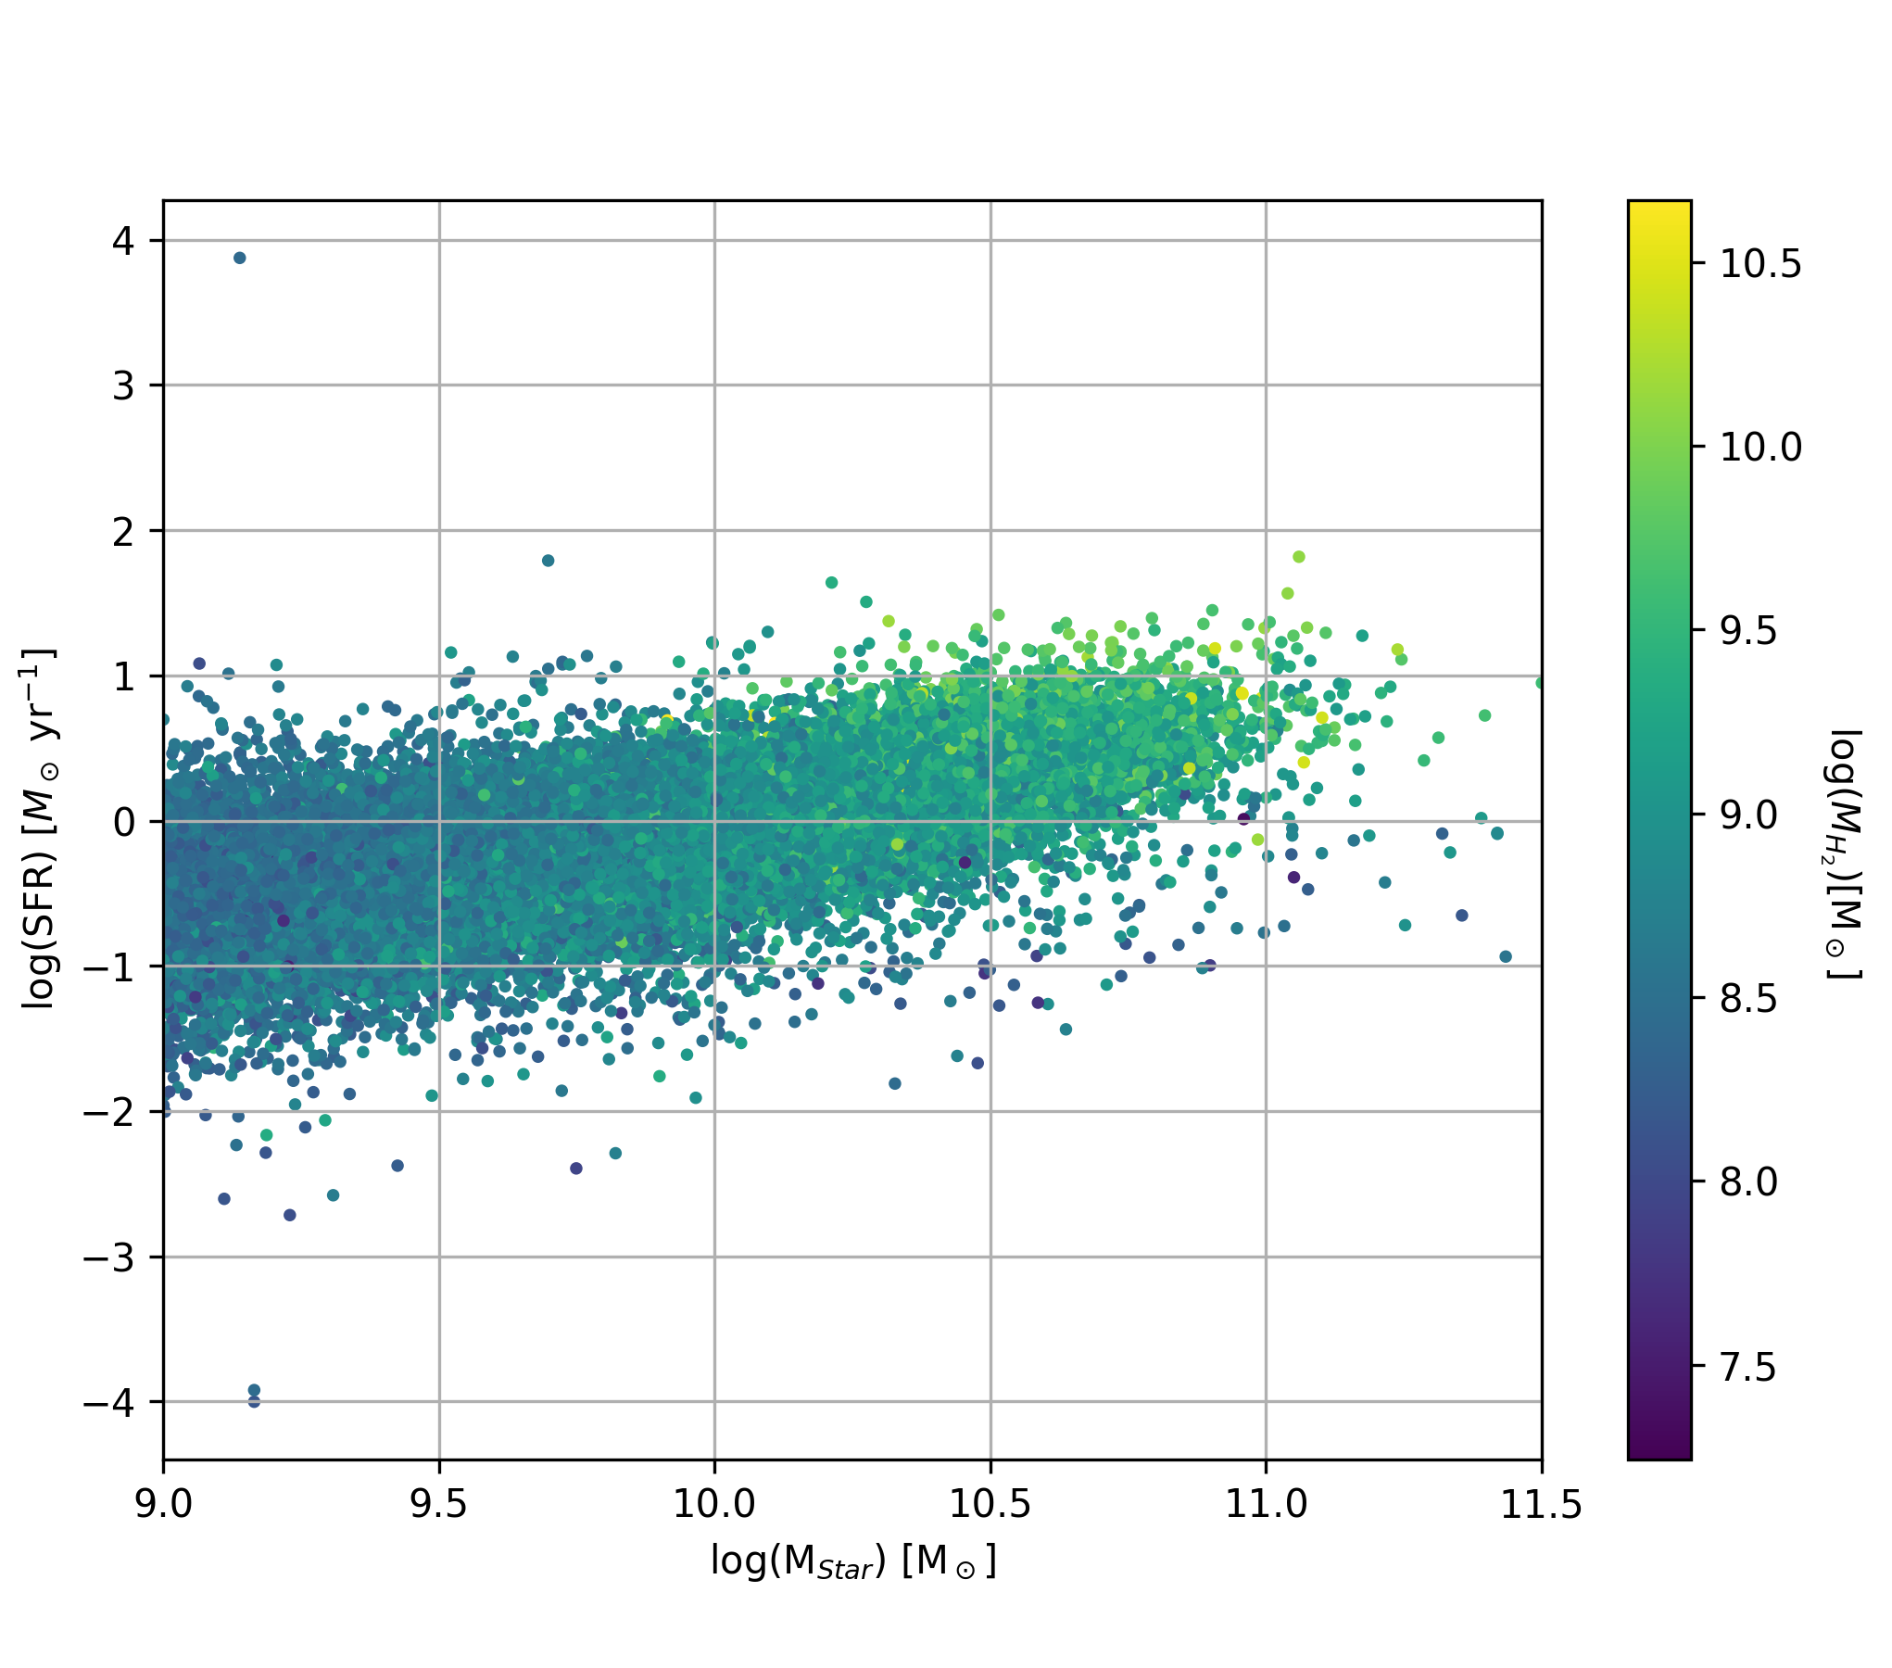

$H_{2}$ in SDSS galaxies
H₂ content increases proportionally with stellar mass
From Balmer emission measurements, it is possible to construct accurate cold-gas estimates for star-forming galaxies

Slide 28
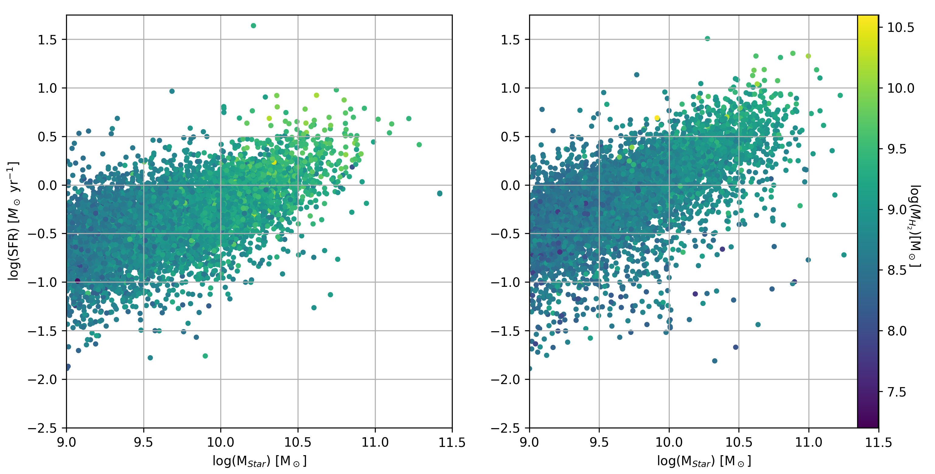

$H_{2}$ in SDSS galaxies
i>73º
i<36º

Slide 29
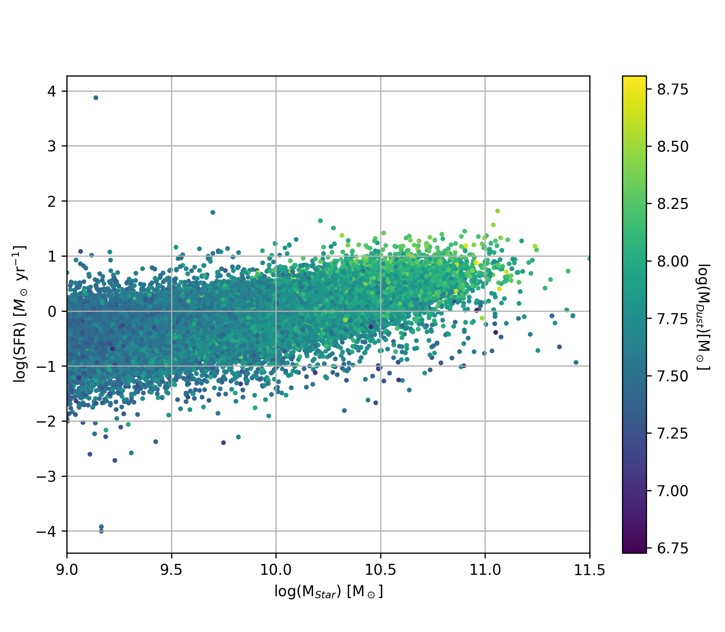
Dust in SDSS galaxies
Dust content increases proportionally with stellar mass
From Balmer emission measurements, it is possible to construct accurate dust estimates for star-forming galaxies

Slide 30
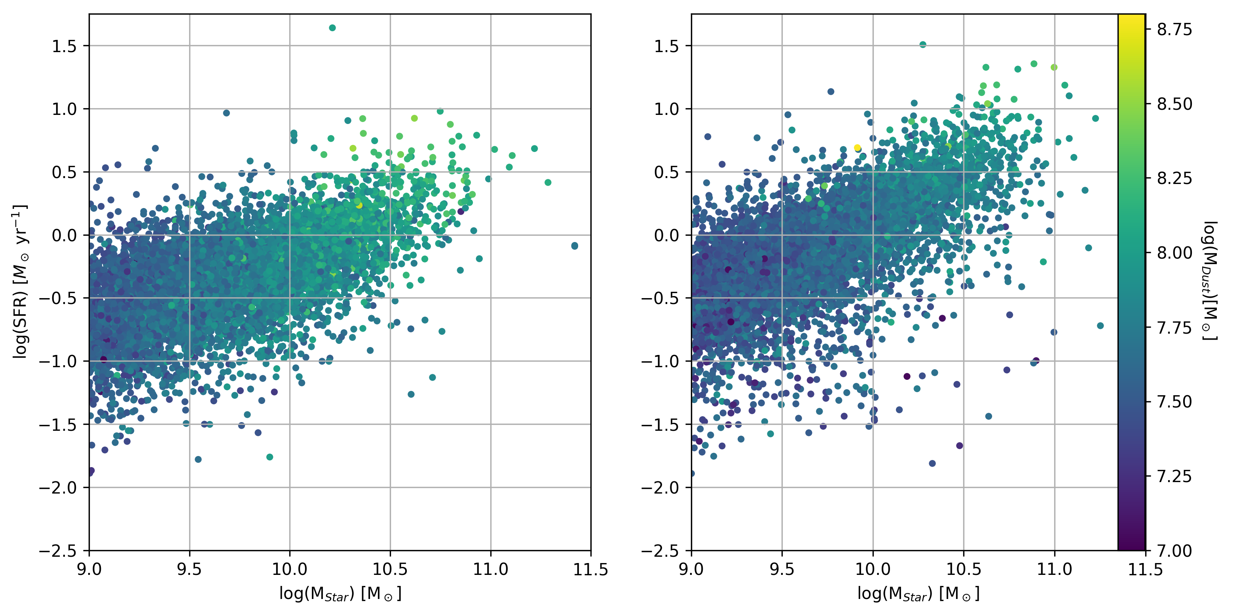
Dust in SDSS galaxies
Galaxies separated by inclination
Edge on galaxies exhibit
i>73º
i<36º

Slide 31

Central conclusions
Calibration of $L_{{CO}_{1→0}}$ dependent on metallicity
H₂ and dust calibration independent of metallicity, minor dependence on inclination
Calibrators show consistency across SDSS sample
Inclination dependent within SDSS sample
$$M_{∎}=m_{1}\left(\frac{F_{H⍺}}{F_{Hβ}}\right)+m_{2}\left(i\right)+b$$

Slide 32

What is included in the calibration?
Gas phases of a galaxy
Molecular
Derived using calibration
Ionized atomic
Traced with $H⍺$ emission
Neutral atomic
Traced with 21cm spin flip transition
Dust derived from calibration
Stellar mass widely accessible from photometry
In search of baryonic mass function $→ M_{stars}+M_{gas}+M_{dust}$

Slide 33

Future studies
Dark matter is central to early stages of galaxy evolution
Though abundant, observational signatures scant
Dark Energy Spectroscopy Instrument
Constrain dark energy theories
Study large scale structure distribution in universe
In pursuit of a total matter function
$$\frac{M_{stars}+M_{gas}+M_{dust}}{M_{Dark Matter}}$$

Slide 34
I wouldn’t be here without some help
Amélie Saintonge
John Collins
Dipankar Maitra
Tommy Ratliff

Slide 35

Conclusions
Calibration of $L_{{CO}_{1→0}}$ dependent on metallicity
H₂ and dust calibration independent of metallicity, minor dependence on inclination
Calibrators show consistency across SDSS sample
Inclination dependent within SDSS sample
$$M_{∎}=m_{1}\left(\frac{F_{H⍺}}{F_{Hβ}}\right)+m_{b}\left(i\right)+b$$

Slide 36
Figure references
Gendler, Robert. “APOD: 2019 June 29 - M83: The Thousand Ruby Galaxy.” NASA, NASA, 29 June 2019, apod.nasa.gov/apod/ap190629.html.
“Imaging Camera Parameters and Description.” Imaging Camera Description - SDSS DR7, classic.sdss.org/dr7/instruments/imager/index.html.
Spectra from SDSS quicklook - https://skyserver.sdss.org/dr12/en/tools/quicklook/summary.aspx?plate=2104&mjd=53852&fiber=195
Dust extinction illustration - courtesy of Nick Strobel at www.astronomynotes.com
“NGC 1055.” Eso.org, 1 Mar. 2017, www.eso.org/public/news/eso1707/.
Concas, Alice, and Paola Popesso. “A New Empirical Method to Estimate the Molecular Gas Mass in Galaxies.” Monthly Notices of the Royal Astronomical Society: Letters, vol. 486, no. 1, 2019, doi:10.1093/mnrasl/slz065.
“IRAM 30m Telescope.” IRAM 30m Telescope, 20 Jan. 2009, www.iram.es/IRAMES/newfrontpage/.
Lamperti, Isabella, et al. “JINGLE V: Dust Properties of Nearby Galaxies Derived from Hierarchical Bayesian SED Fitting.” Monthly Notices of the Royal Astronomical Society, 2019, doi:10.1093/mnras/stz2311.
“An SDSS Plate.” SDSS, Sloan Digital Sky Survey, www.sdss.org/plate-sdss/.
“Sloan Foundation 2.5m Telescope.” SDSS, Sloan Digital Sky Survey, www.sdss.org/instruments/.
Chung, Marilyn. “A View of the Interior of the Mayall Telescope at Kitt Peak National Observatory.” Desi.lbl.gov, 10 July 2018, photos.lbl.gov/bp/#/folder/4478426/77050241.
Figures and plots generated with matplotlib

Slide 37
Extra Slides

Slide 38
Stages in galaxy growth
Cosmic inflation
Initial conditions of a hot, homogeneous universe
Amplification of quantum fluctuations of matter
Recombination
Previously, photon pressure prevented gravitational collapse
Photon decoupling from baryonic matter granted collapse of baryonic matter
Reionization
Earliest stars formed from collapsing clouds of gas
Stars clustered to form intricate structure of galaxies

Slide 39
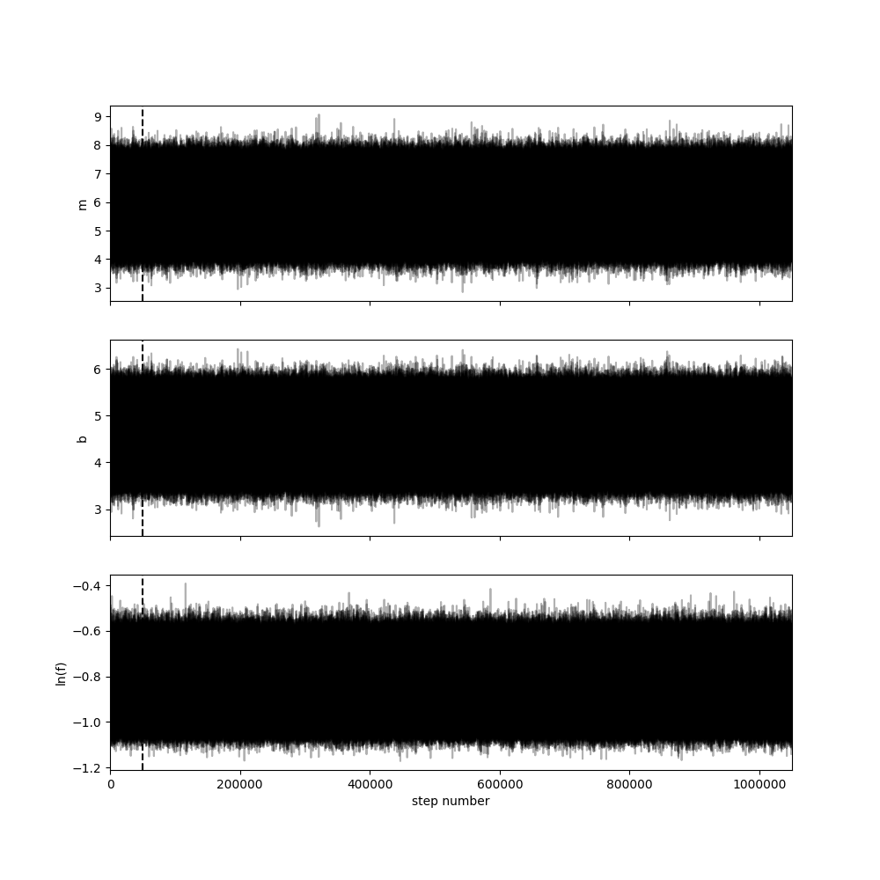


Monte-Carlo Markov chain
Optimize $M_{∎}=m×\left(\frac{F_{H⍺}}{F_{Hβ}}\right)+b$ with $M_{∎}=\left\{L_{{CO}_{1→0}},M_{H_{2}},M_{Dust}\right\}$

Slide 40

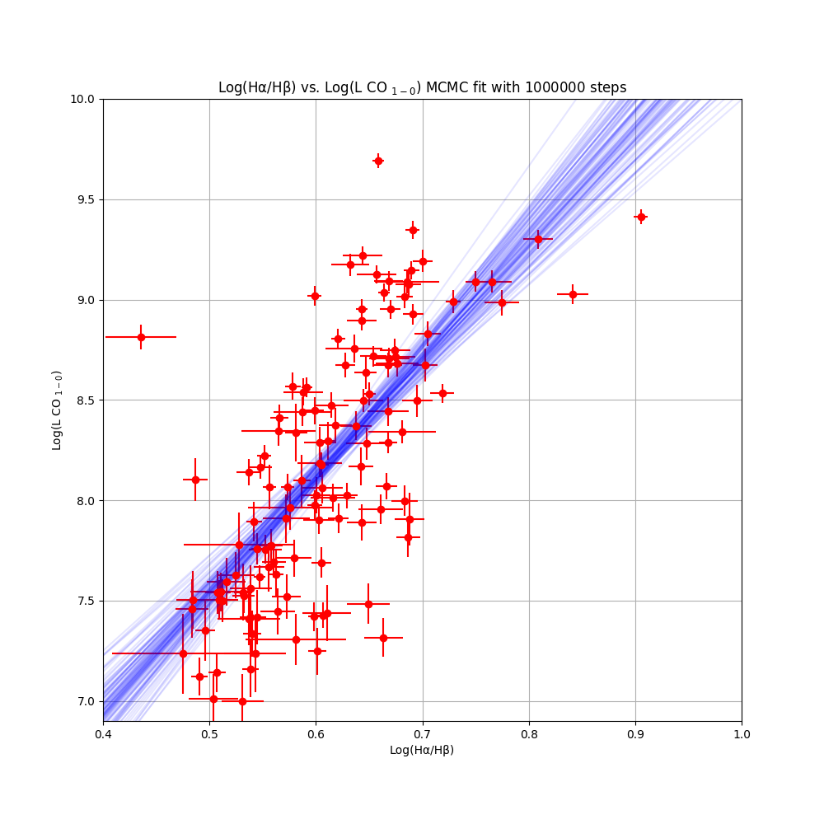
$L_{{CO}_{1→0}}$ calibration

Slide 41
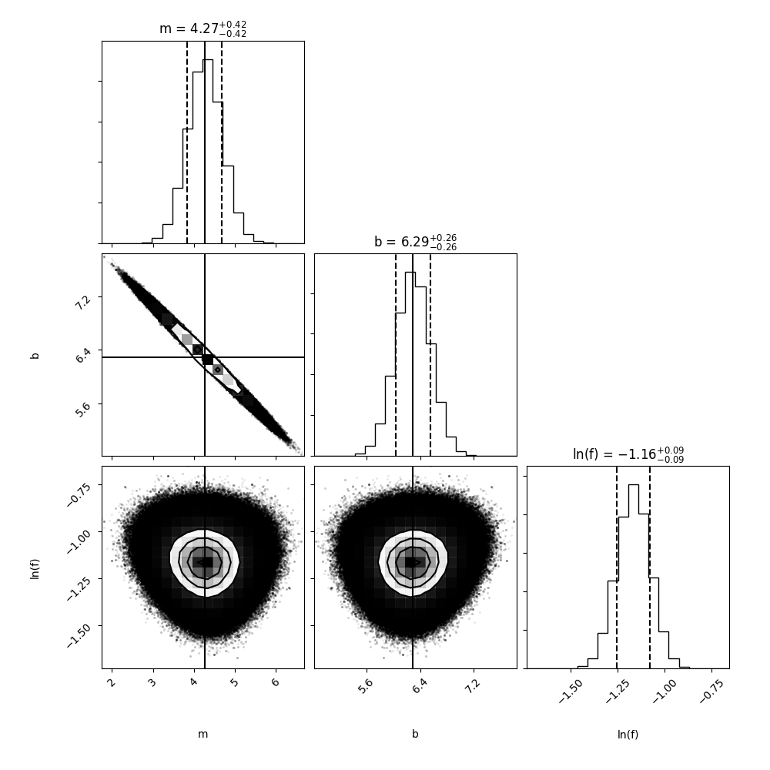
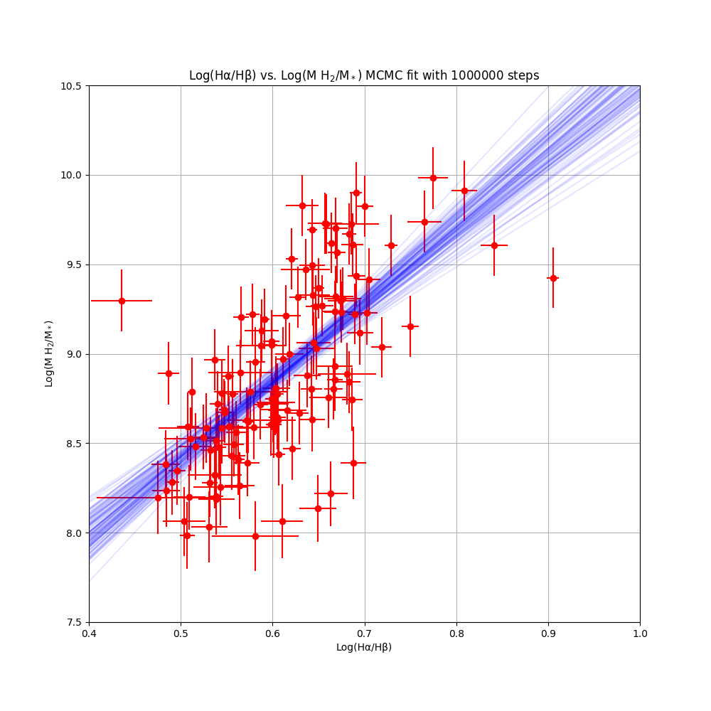
$M_{H_{2}}$ calibration

Slide 42
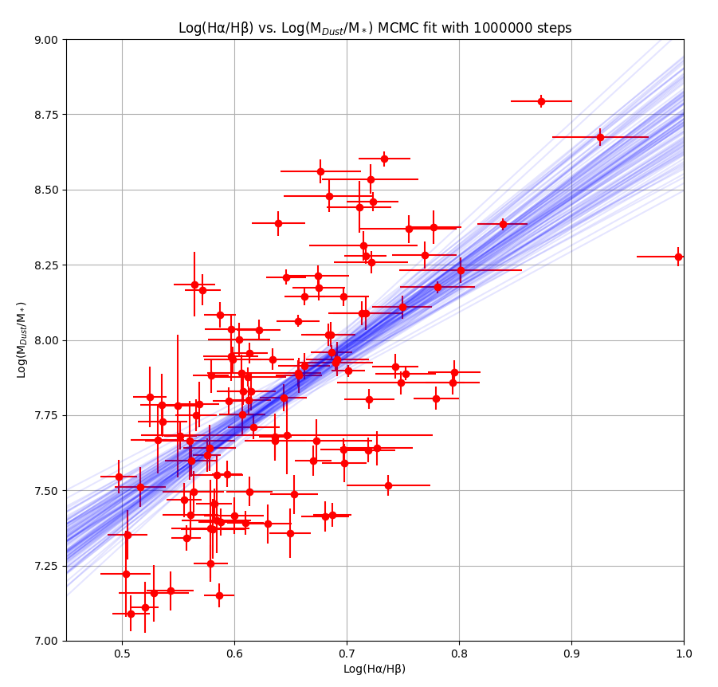
$M_{Dust}$ calibration

Slide 43

$f_{H_{2}}$ in SDSS galaxies

Slide 44
$f_{H_{2}}$ in SDSS galaxies

